Slide 1
Analysis of the impact on the Alpha and Beta companies due to recent events.
By Team 5
Data gathered for the duration of Oct 2019 - Apr 2020

Slide 2
Industries that represent Alpha and Beta, are namely Air-Travel and IT Tech
The impact of the events that took place on the economy and a bit about the challenges that are faced.
Timelining the events that took place :
SARS-CoV-2 nCoV-19 outbreak.
US-Sino Trade Wars.
Ban imposed on China based technology and services.
Impact on Travel on Hospitality industry
Global semiconductor crisis
Supply chain crisis
Trouble over Oil Prices

Slide 3
Market Players :
The players that stood out / stayed afloat during the period:
Zoom Video Communications.
NVIDIA Corporation.
Advanced Micro Devices.
RingCentral Inc.
The other Airline Folks that took a hit during the period:
Cebu Air Inc.
Boeing.
Jet Airways.
AirAsia Berhad.

Slide 4
Dataset description
Date | Alpha | Beta | Alpha Unit Price | Beta Unit Price | Share A | Share B | Twitter A | Twitter B
10-27-2019 | 67 | 97 | 4000 | 4610 | 70 | 63.2 | 1 | 0
10-28-2019 | 81 | 90 | 4000 | 3260 | 78 | 69.3 | 0 | -1
10-29-2019 | 114 | 88 | 2910.73 | 4400 | 74 | 63.2 | 1 | 1
10-30-2019 | 100 | 98 | 4000.98 | 4260 | 72 | 63.2 | 1 | -1
10-31-2019 | 107 | 98 | 4550.06 | 4920 | 73 | 75 | 0 | 0
11-01-2019 | 138 | 99 | 4980 | 4500 | 78 | 63.2 | 0 | 0
11-02-2019 | 67 | 80 | 4950 | 4700 | 78 | 63.2 | 0 | 1
11-03-2019 | 67 | 85 | 5000 | 4370 | 70 | 63.2 | -1 | 0
11-04-2019 | 70 | 88 | 4100.99 | 4490 | 70 | 63.2 | 0 | 1
11-05-2019 | 77 | 58 | 3280 | 3310 | 70 | 63.2 | -1 | 1
11-06-2019 | 67 | 67 | 4680 | 4310 | 87 | 63.2 | 0 | 0
11-07-2019 | 67 | 80 | 4440 | 3570 | 98 | 65.9 | 0 | 1
11-08-2019 | 80 | 87 | 5000 | 4740 | 88 | 63.2 | -1 | -1
11-09-2019 | 95 | 99 | 4990 | 3590 | 70 | 63.2 | 0 | 1
11-10-2019 | 70 | 89 | 4260 | 4770 | 70 | 63.2 | 0 | 0
11-11-2019 | 70 | 89 | 4470 | 4040 | 70 | 70 | 0 | 0
11-12-2019 | 70 | 98 | 4760 | 3640 | 78 | 63.2 | -1 | 0
11-13-2019 | 98 | 70 | 3330 | 4040 | 74 | 63.2 | 0 | 0
11-14-2019 | 75 | 94 | 3710 | 3360 | 72 | 63.2 | -1 | 0

Slide 5
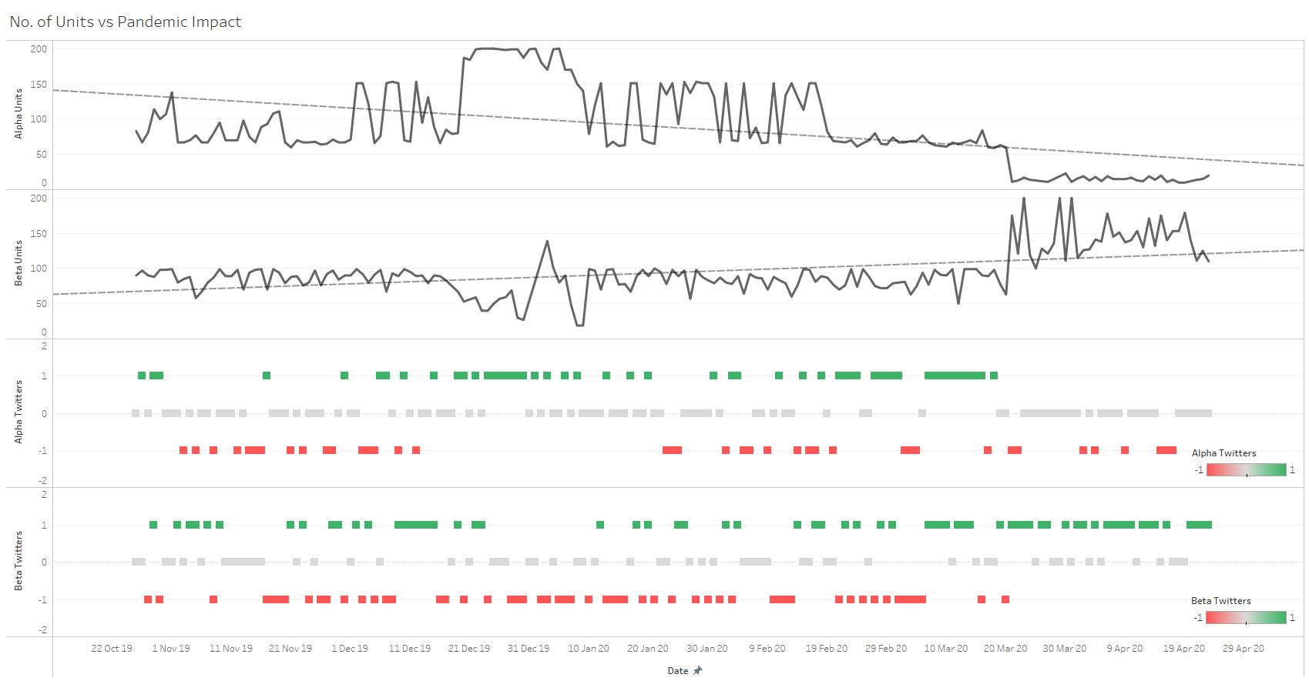
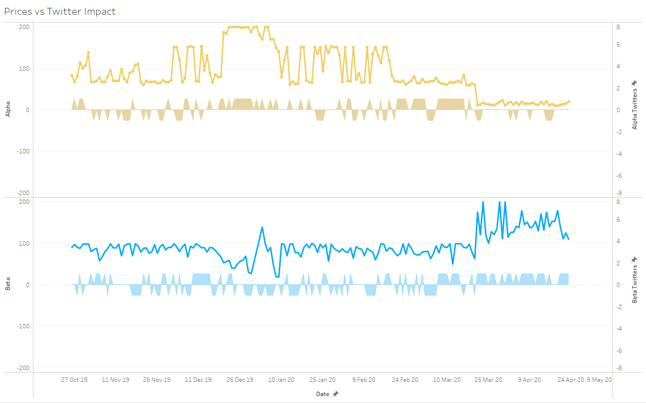
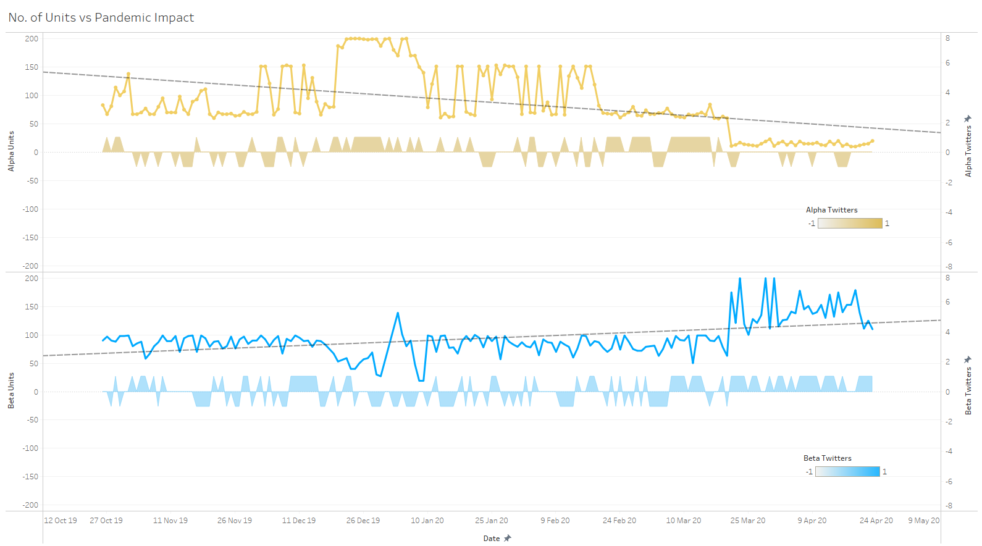


No of Units vs Pandemic Impact Oct 2019 – Apr 2020

Slide 6
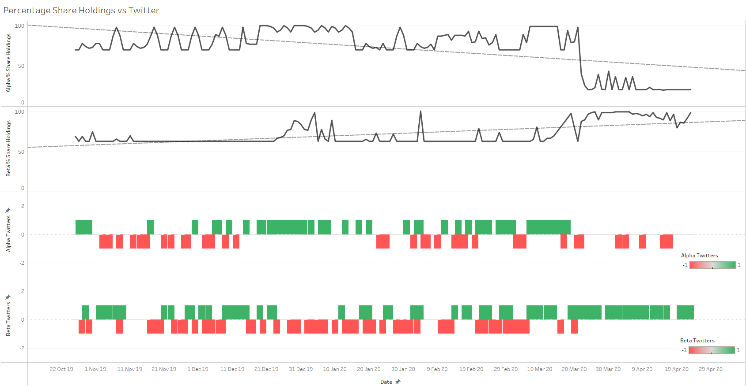
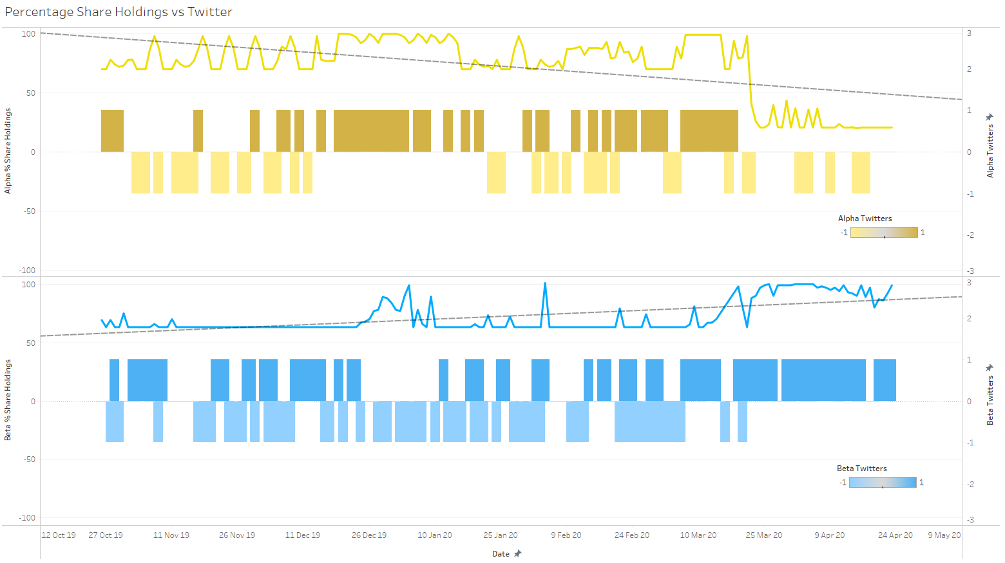
Percentage Share Holdings vs Twitter Impact Oct 2019 – Apr 2020

Slide 7


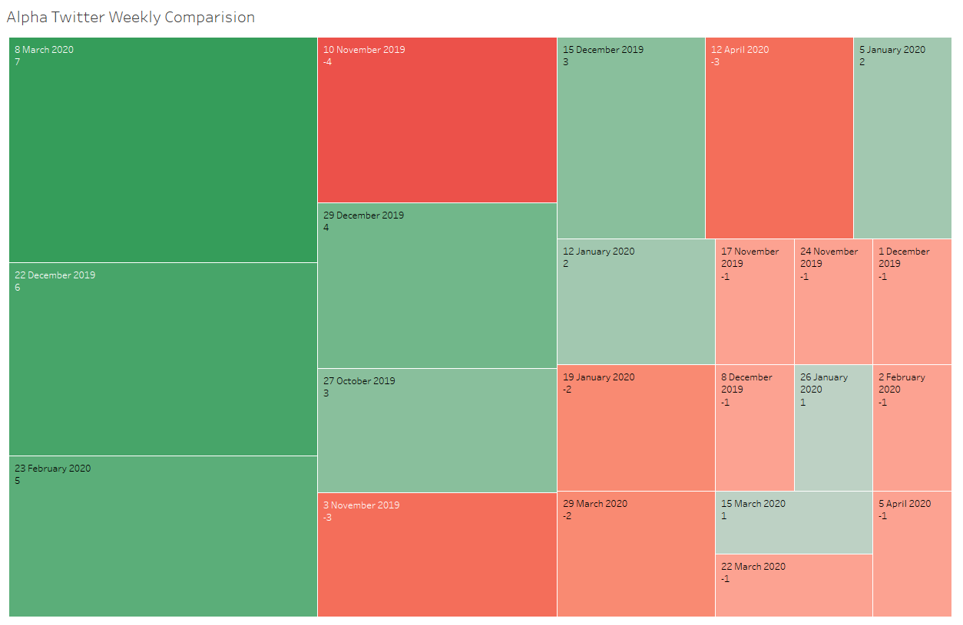
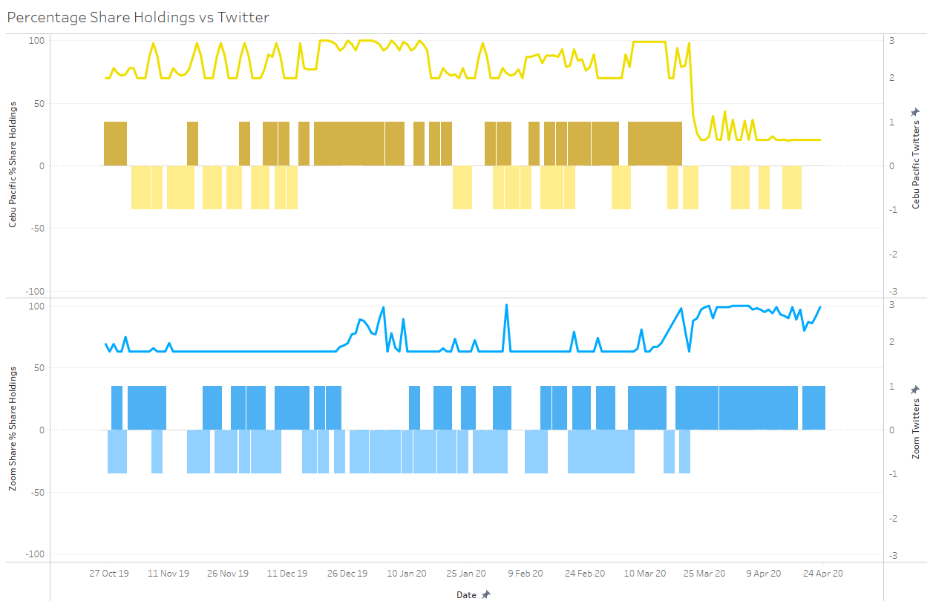
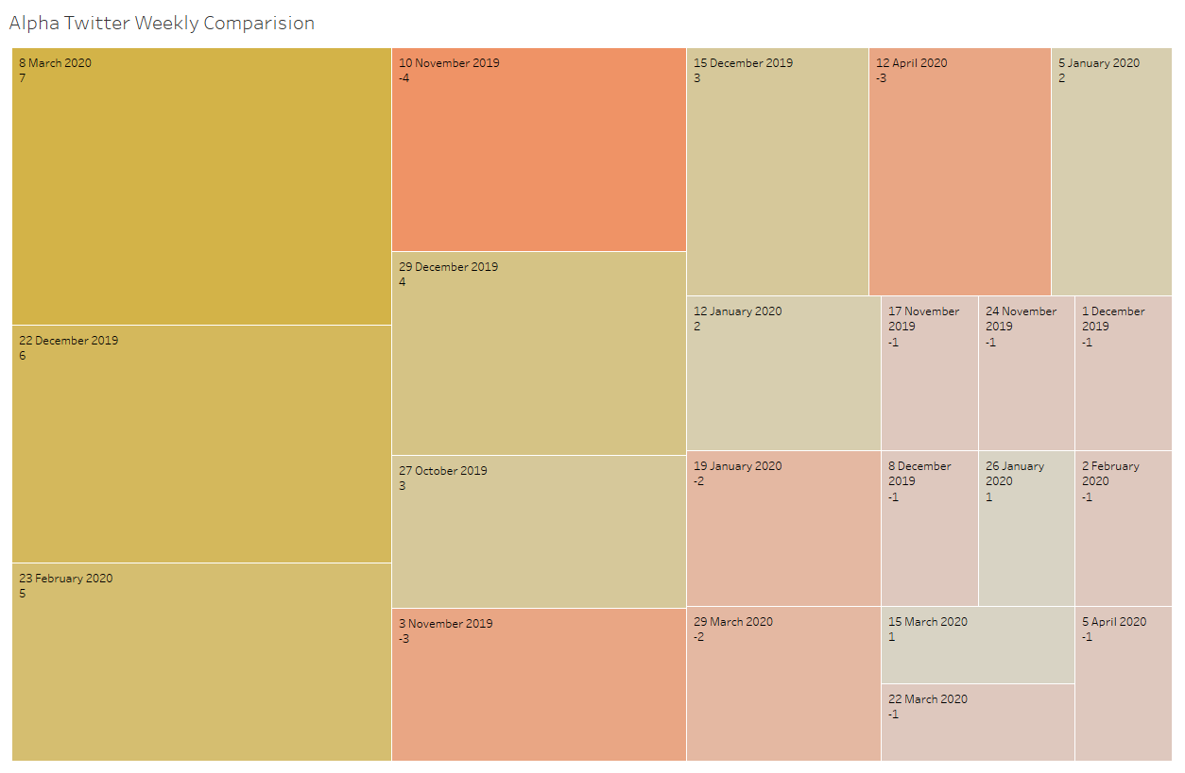
Alpha Twitter Impact over time Oct 2019 – Apr 2020

Slide 8

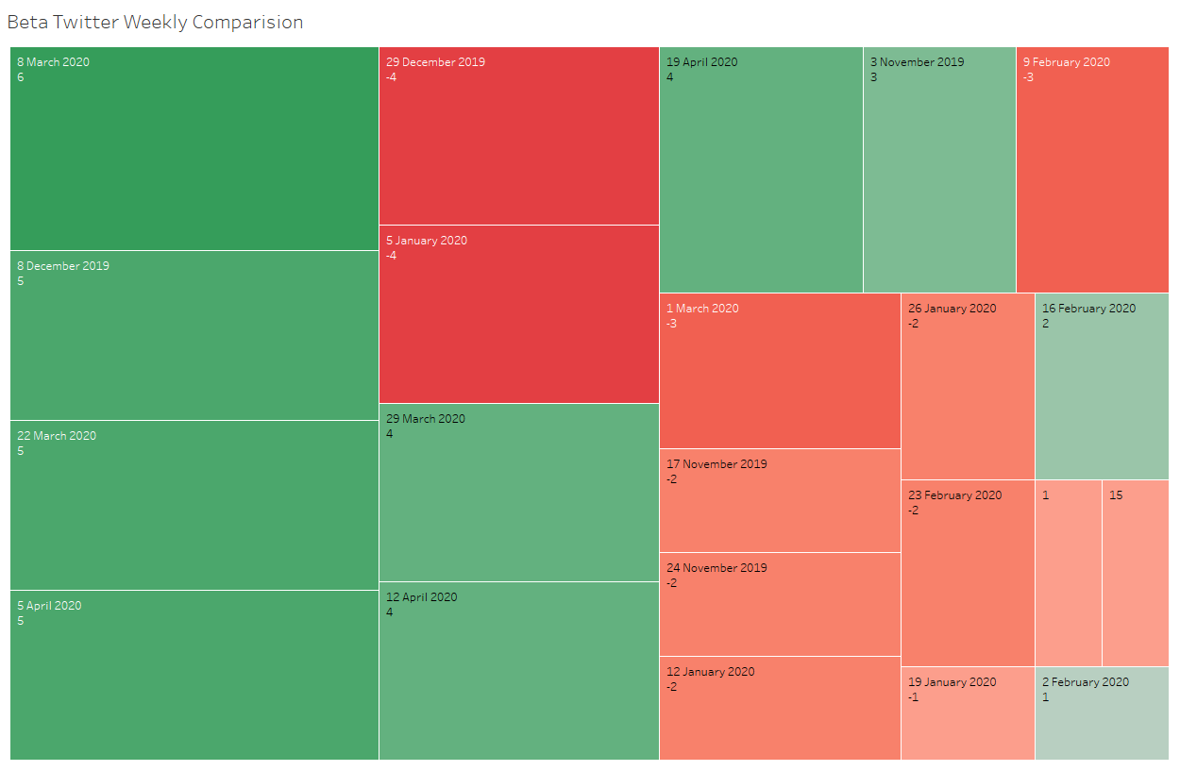
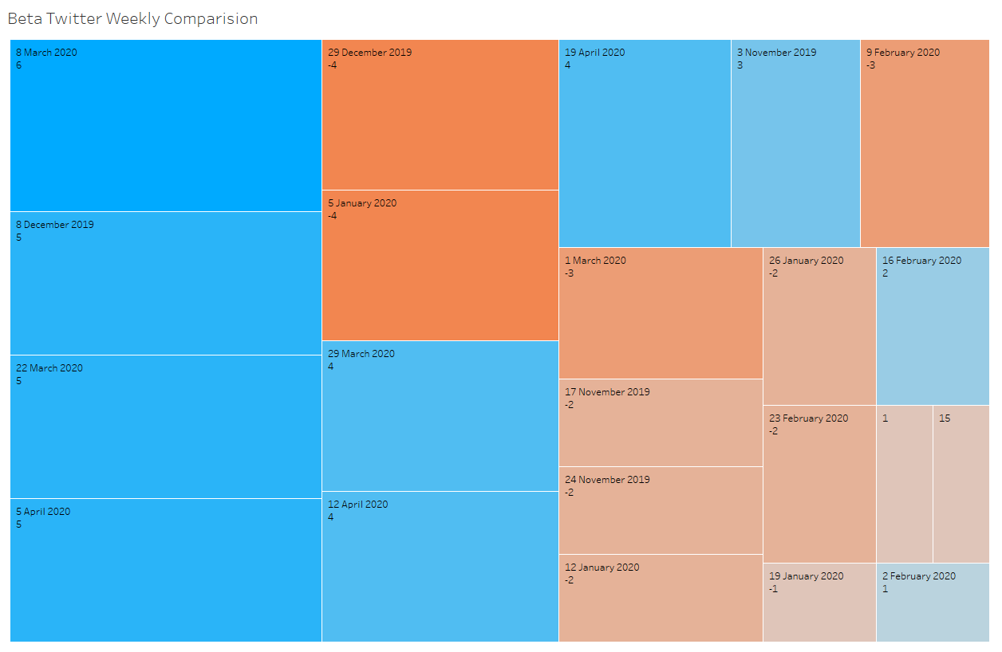
Beta Twitter Impact over time Oct 2019 – Apr 2020

Slide 9
SWOT Analysis
Cebu Air
Strengths
Robust Domestic Market
Superior Quality Services
Successful Track Record
Weaknesses
Lack of Implementation of Technology
Low ROI
Lack of Critical Talent
Opportunities
Strategic Alliances with Tiger Air Group
Lucrative International market Opportunities
Developments in AI
Threats
Upcoming Tycoons in Philippines
Work schedule issues on entering Europe and American operations
Rising Fuel and Labour Costs

Slide 10
SWOT Analysis
Zoom
Strengths
Ease of Use
Niche Product
Brand Name
Unique Features (Whiteboards)
Weaknesses
Ineffective Encryption
Unpolished Features
Security Problems
Opportunities
Increasing Demand
Technological Improvements
Diversification
Threats
Competition
Normalization
Many Substitutes in the Market

Slide 11
Sources
Historical data : Yahoo Finance
Facts on events :
Wiki
PwC forums
News forums
Tech forums
Through our research, the entities representing 2 companies are as follows:
Alpha: Cebu Air Inc.
Beta: Zoom Video Communications.

Slide 12
References
https://en.wikipedia.org/wiki/China%E2%80%93United_States_trade_war
https://en.wikipedia.org/wiki/2020%E2%80%932021_China%E2%80%93India_skirmishes
https://www.whitehouse.gov/cea/written-materials/2021/06/17/why-the-pandemic-has-disrupted-supply-chains/
https://economictimes.indiatimes.com/news/international/business/how-the-global-supply-chain-crisis-unfolded-this-year/articleshow/88486682.cms
https://hbr.org/2020/09/global-supply-chains-in-a-post-pandemic-world
https://www.pwc.com/sg/en/publications/a-resilient-tomorrow-covid-19-response-and-transformation/the-coronavirus-and-its-consequences-industry-in-crisis-mode.html

Slide 13
Thank you !
Presentation by Team 5 :
Joshua Ryan Lawrence Dsouza
Meghana Jannavada
Samarth G
Suman Sourabh
Suvodeep Das
Jervis Anthony Saldanha

